Slide 1





ITM 498-06
Andreive Giovanini Silva
Breno Soares Martins
Pedro Henrique Gualdi

Slide 2



INTELLIGENT LIGHTS
We are surrounded by lights.
Sensors are becoming more present in our lives every day.
Why not integrate lights and sensors and make them smart?

Slide 3
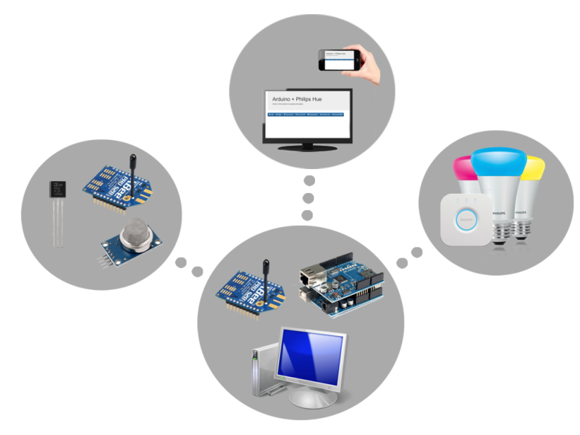
OUR GOAL
Create a mesh network with Arduino, XBee, sensors and the Philips Hue lighting system.

Slide 4

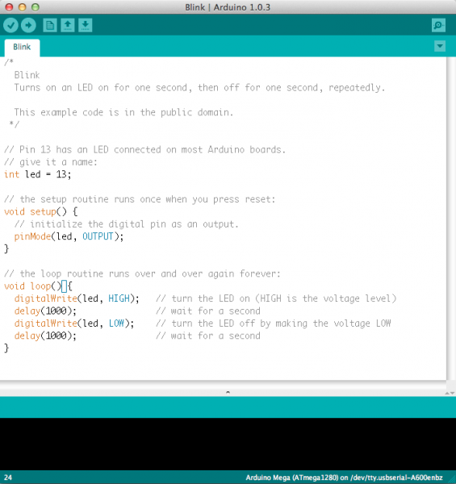
Arduino
Open-source platform
Available IDE to design software
Plenty of peripherals and compatible sensors

Slide 5
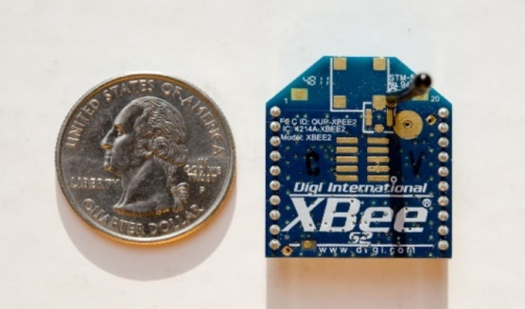


Xbee DigiMesh 2.4
Radio modules
IEEE 802.15.4 networking protocol for fast point-to-multipoint or peer-to-peer networking
VS
Limited range
“Pairing” connection
Limited range
High power consumption
Notes:
http://arduino.stackexchange.com/questions/3270/whats-the-difference-between-rf-options-wifi-xbee-nrf24l01

Slide 6
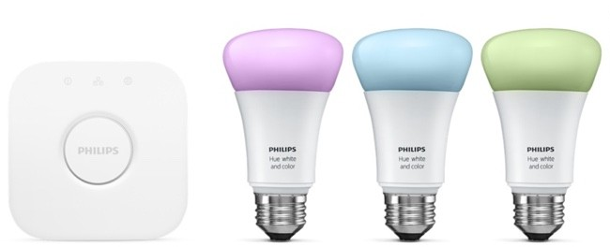
Philips Hue
Wireless capabilities
Can be controlled by JSON strings
Philips Hue Bridge

Slide 7
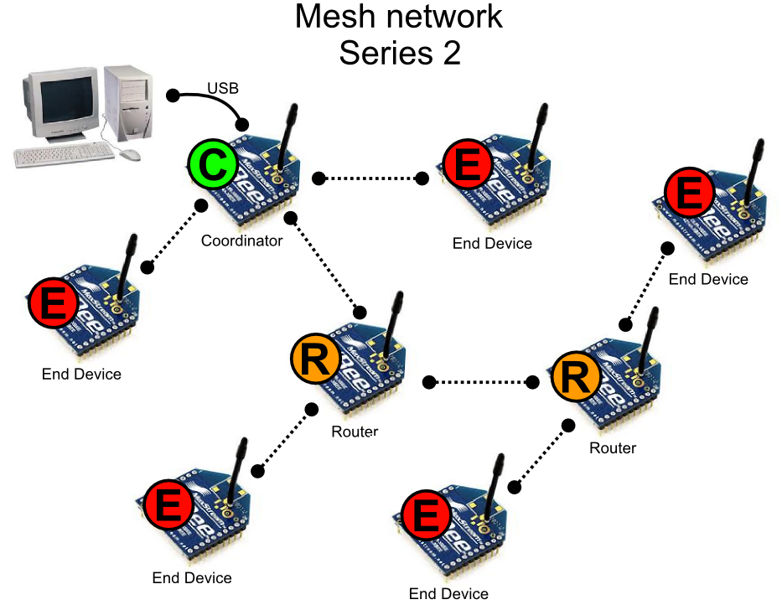
MESH NETWORK
For a valid network: one coordinator, n routers, m end devices
Serial over USB
Notes:
Think of it as a spider web. A mesh network is a local area network that employs one of two connection arrangements, full mesh topology or partial mesh topology. A mesh network is reliable and offers redundancy. If one node can no longer operate, all the rest can still communicate with each other, directly or through one or more intermediate nodes.

Slide 8
OUR GOAL
Create a mesh network with Arduino, XBee, sensors and the Philips Hue lighting system.

Slide 9
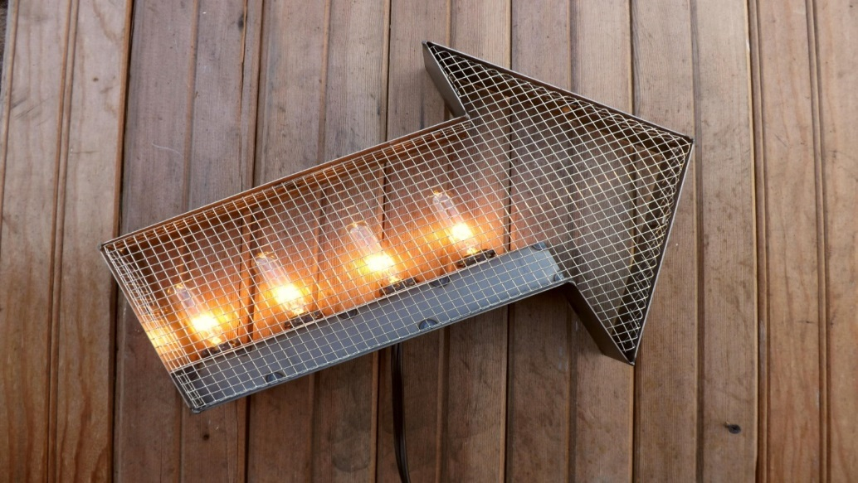
WHY?
Not everyone can hear an alarm system.
Not everyone can find where they want to go.

Slide 10
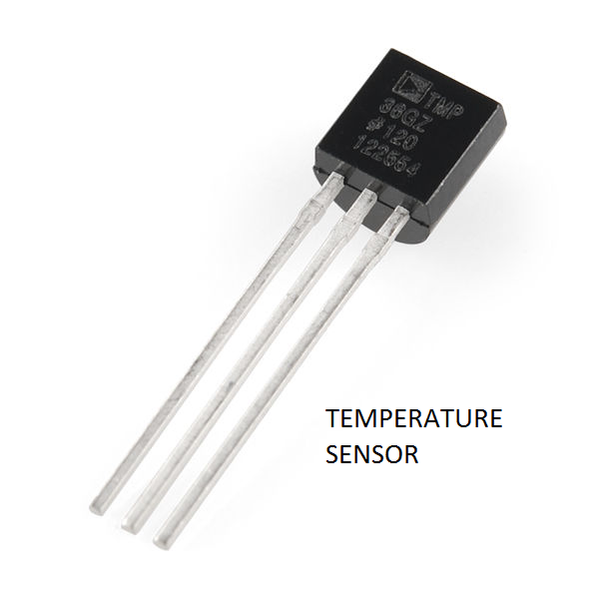
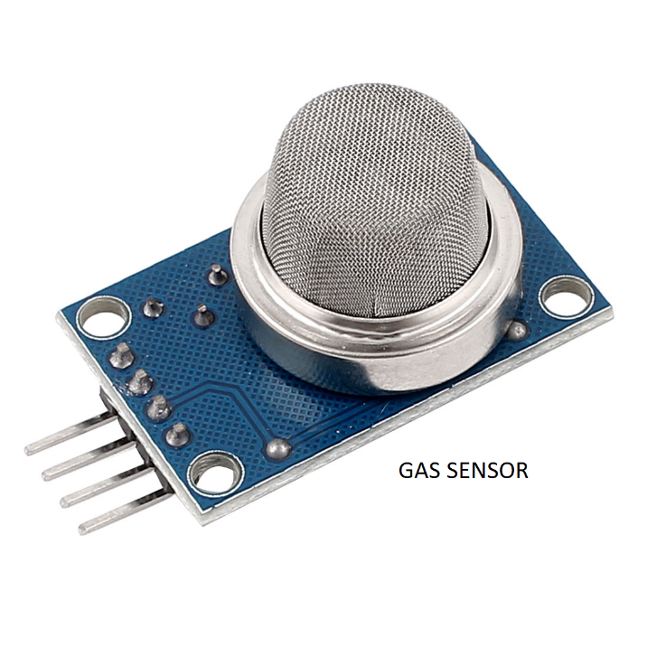
HOW?
Collection of information via sensors.

Slide 11
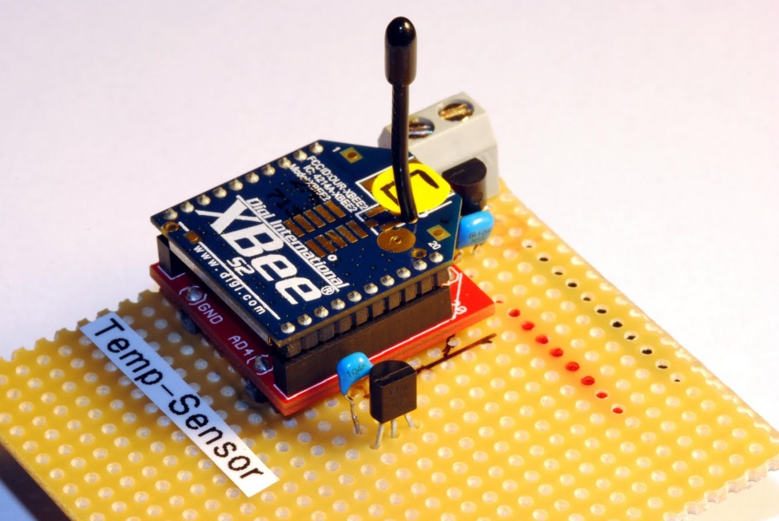
HOW?
A XBee attached to each sensor transmitting its data.

Slide 12
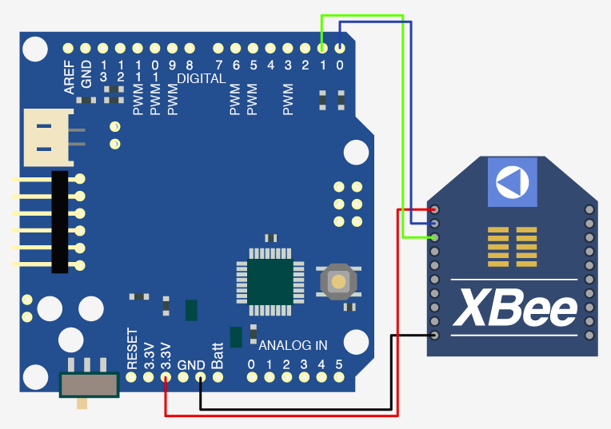
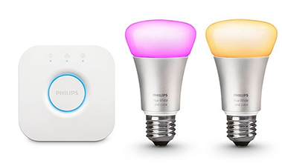
HOW?
A central Arduino that receives data and sends commands to lamps.

Slide 13
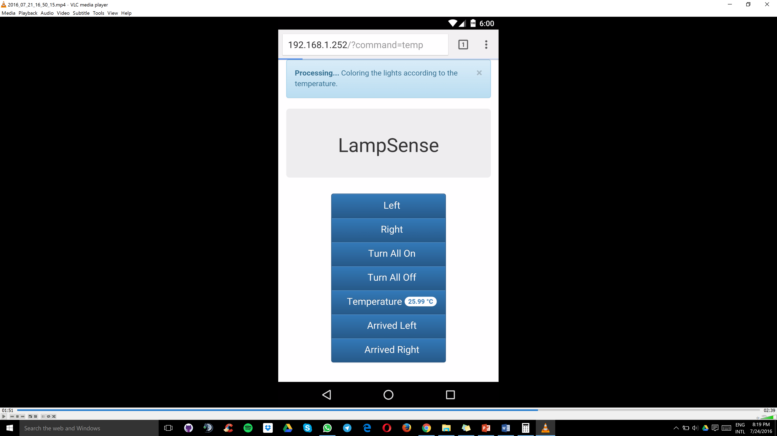
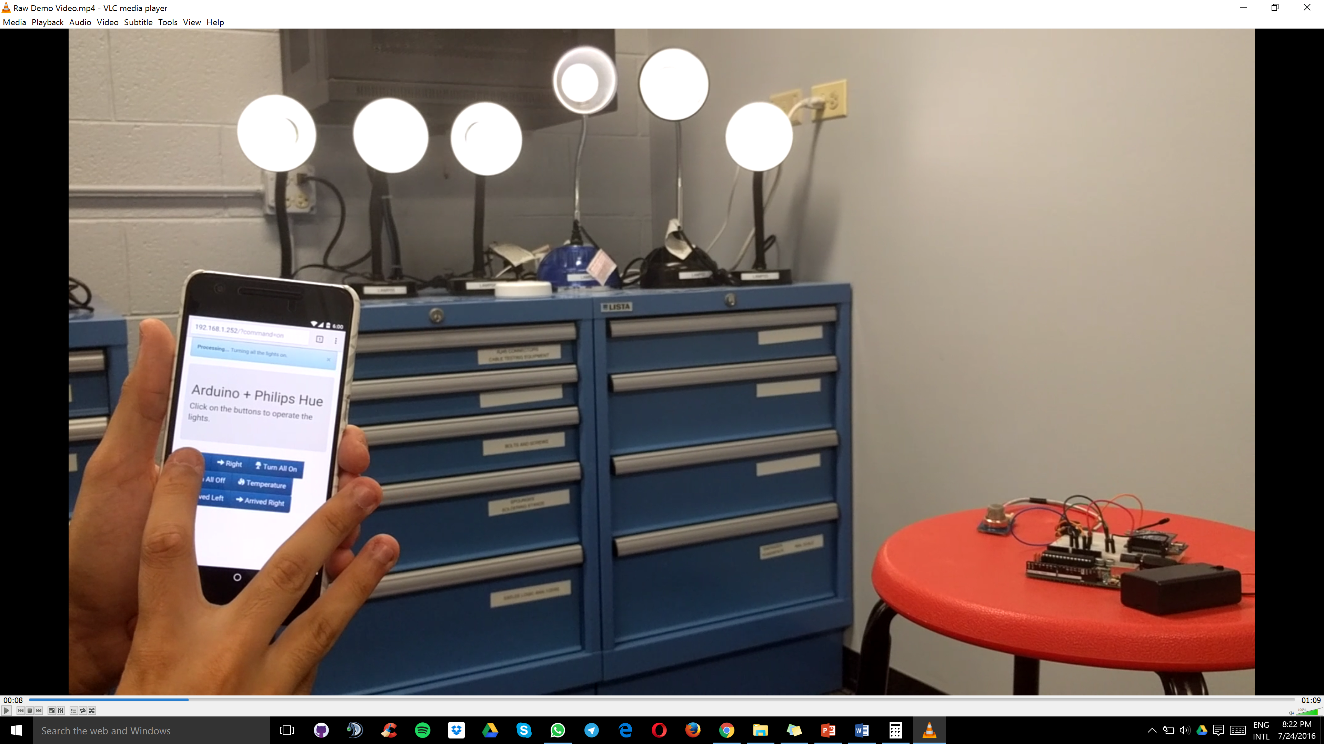
HOW?
A HTML page generated by Arduino that accepts commands from a user.

Slide 14
STATE MACHINE
Receive data from XBees
Analyze gas level
Update connection and HTML page
Check lamp state and update
Send data to database
Check for Serial input
Check if button was pressed

Slide 15
HOW MUCH?
MATERIAL | UNIT COST | QUANTITY | TOTAL COST
Arduino Mega | $ 45.95 | 1 | $ 45.95
Arduino Ethernet Shield R3 | $ 45.00 | 1 | $ 45.00
Xbee DigiMesh 2.4 | $ 19.00 | 4 | $ 76.00
Philips Hue Starter Kit | $ 199.00 | 2 | $ 398.00
TMP36 Temperature Sensor | $ 1.50 | 2 | $ 3.00
MQ-2 GAS Sensor | $ 3.99 | 1 | $ 3.99
Internet Cable | $ 9.49 | 2 | $ 18.98
3.7V Battery | $ 9.95 | 3 | $ 29.85
 |  | FINAL COST: | $ 620.77
MATERIAL | UNIT COST | QUANTITY | TOTAL COST
Arduino Mega | $ 45.95 | 1 | $ 45.95
Arduino Ethernet Shield R3 | $ 45.00 | 1 | $ 45.00
Xbee DigiMesh 2.4 | $ 19.00 | 4 | $ 76.00
Philips Hue Starter Kit | $ 199.00 | 2 | $ 398.00
TMP36 Temperature Sensor | $ 1.50 | 2 | $ 3.00
MQ-2 GAS Sensor | $ 3.99 | 1 | $ 3.99
Internet Cable | $ 9.49 | 2 | $ 18.98
3.7V Battery | $ 9.95 | 3 | $ 29.85
 |  | FINAL COST: | $ 620.77
Notes:
So, here's a table that shows the estimated costs for the equipment that we are using on our project.
The total cost is about six hundred twenty dollars.
As we can see, we are using two Philips Hue Starter Kits, which represent about two-thirds of the total cost.
The wireless lighting system seems too expensive if compared to the other equipments used on the project.

Slide 16

CHALLENGES
How to power the system for a very long time?
Notes:
Now, let's talk a little bit about the challenges that we faced during the development of our research.
The first one was how to power Arduino boards and XBee modules for a reasonable time.

Slide 17

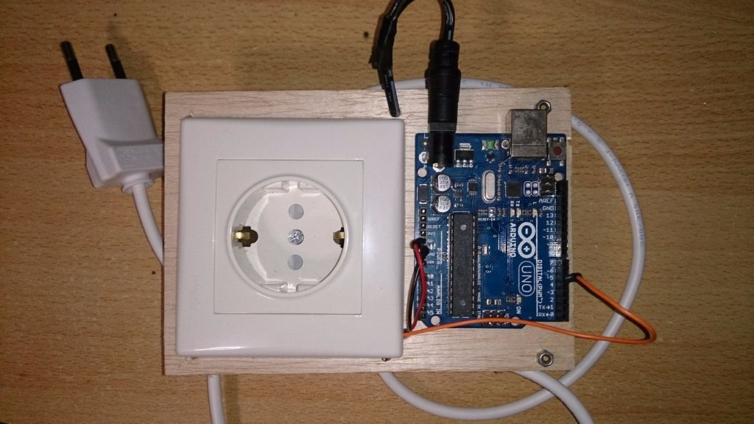
CHALLENGES
Base connected to a wall socket
Sleep mode on XBees with sensors
Notes:
The prototype base must stay plugged into a wall socket all the time.
However, the XBee modules use batteries. A solution to reduce power consumption is the XBee sleep mode.

Slide 18

CHALLENGES
Cost: lamps are still too expensive!
Future projects: build our own lamp
Notes:
The second challenge was about cost. As I mentioned before, the lighting system used is pretty expensive. That could be a problem in the case of a building with hundreds of light bulbs.
A possible solution for that is to work with a cheaper alternative or to develop our own lighting system.

Slide 19
WHAT CAN LAMPSENSE PROVIDE?
Wouldn’t it be great if the lights of our buildings reacted to the presence of gas in case of fire or gas leak?
What if the lights could show the way to a specific room you want to go?
Notes:
So, what can our product provide?
Wouldn't it be great if the lights could signal an emergency, like a gas leak?
Or, what if the lights illuminate the path to your destination?
Let's see what LampSense can do by watching the following demo video.

Slide 20

DEMO VIDEO
Royalty Free Music from Bensound

Slide 21
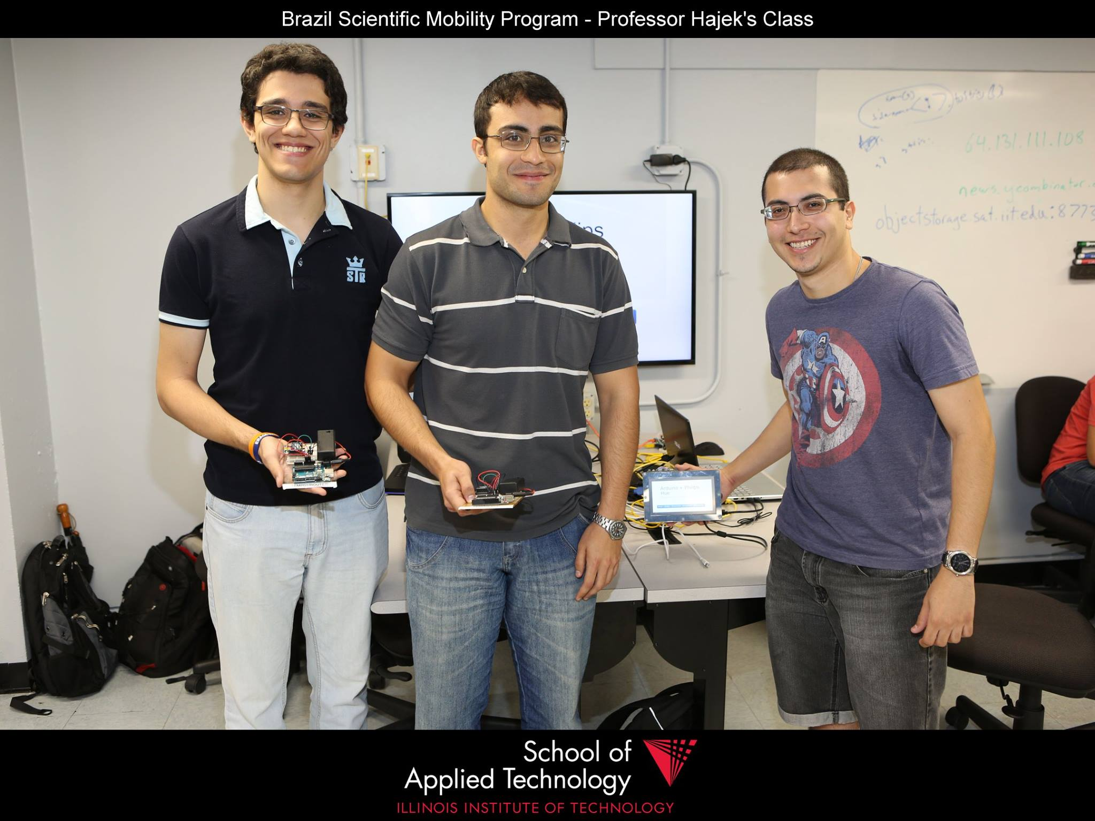

THANK YOU!
Pedro Henrique Gualdi
Andreive Giovanini
Breno Martins
Professor Jeremy Hajek

Slide 22




ACKNOWLEDGEMENTS

Slide 23
REFERENCES
Faludi, Robert. “Building Wireless Sensor Networks”, 1st edition, O’Reilly Media, Inc, 2010.
Logitech. Harmony experience with Philips wireless lighting. Retrieved 07/2016 from: https://support.myharmony.com/en-us/harmony-experience-with-philips-hue
Adafruit. TMP36 Temperature Sensor. Retrieved 07/2016 from: https://learn.adafruit.com/tmp36-temperature-sensor/overview
Sandbox Electronics. MQ-2 Smoke/LPG/CO Gas Sensor Module. Retrieved 07/2016 from: http://sandboxelectronics.com/?product=mq-2-smokelpgco-gas-sensor-module
Arduino. Arduino UNO and Genuino UNO. Retrieved 07/2016 from: https://www.arduino.cc/en/Main/ArduinoBoardUno
Arduino. Arduino Ethernet Shield. Retrieved 07/2016 from: https://www.arduino.cc/en/Main/ArduinoEthernetShield
Arduino. Arduino Mega. Retrieved 07/2016 from: https://www.arduino.cc/en/Main/arduinoBoardMega
Digi. Xbee DigiMesh 2.4. Retrieved 07/2016 from: http://www.digi.com/products/xbee-rf-solutions/modules/xbee-digimesh-2-4

